Slide 1
Powers and roots using a calculator
Properties of number: factors, multiples, squares and cubes

Slide 2
how to use Oak lessons

Slide 3
I can use the keys for squares and other powers and square root on a calculator.

Slide 4

Evaluate means to find the value of a numerical or an algebraic expression.
Example
Example
Evaluate
Evaluate
100 ÷ 2 + 5
= 55
8 + 8
= 16

Slide 5

Powers and roots using a calculator
Evaluate using square and square root buttons
Evaluate using exponents
× 10^{x} button on a calculator

Slide 6
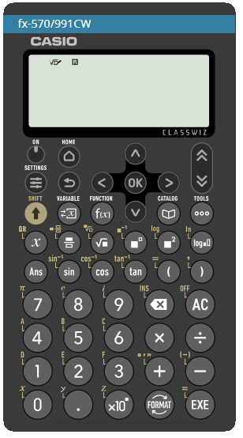
Evaluate using square and square root buttons
There are lots of different scientific calculators, but all have very similar functionality and notation.

Slide 7

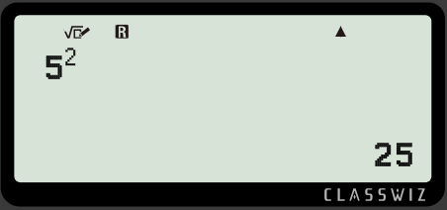


Evaluate using square and square root buttons
This is the “square” button. It will square the number.
Example
= 25
Evaluate
Press

Slide 8
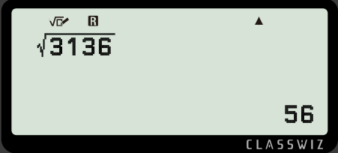




Evaluate using square and square root buttons
This is the “square root” button. It finds the square root of any number.
Example
Evaluate
= 56
Press

Slide 9


Evaluate using square and square root buttons
Remember the inverse relationship between “square” and “square root”.

Slide 10


Evaluate using square and square root buttons
Also note that not all square roots of a number will be an integer. Only the square root of a perfect square will evaluate to an integer.

Slide 11





Evaluate using square and square root buttons
Fill in the missing numbers using your calculator. If your answer is a decimal, write all the digits from your calculator display.
Evaluate
b) Evaluate
c) Evaluate
d) Evaluate

Slide 12




Evaluate using square and square root buttons
Evaluate the following. If your answer is a decimal, write all the digits from your calculator display.
Evaluate
b) Evaluate
c) Evaluate
d) Evaluate

Slide 13
Evaluate using square and square root buttons
2) Using a calculator, work out the missing lengths of the following shaded areas. Each shape is a square.
Area = 0.00 000 1 m²
Area = 127.69 cm²
Area = 4.6225 m²

Slide 14
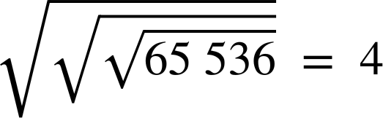

Evaluate using square and square root buttons
3) Using a calculator, explain why the following evaluate to the answer given.
a)
b)

Slide 15
Evaluate using square and square root buttons
Evaluate the following. If your answer is a decimal, write all the digits from your calculator display.
11.9025
Evaluate
181
b) Evaluate
3.47
c) Evaluate
15
d) Evaluate

Slide 16



Evaluate using square and square root buttons
2) Using a calculator, work out the missing lengths of the following shaded areas. Each shape is a square.
Area = 0.00 000 1 m²
Area = 127.69 cm²
Area = 4.6225 m²
Length =
Length =
Length =
Length = 0.001 m
Length = 11.3 cm
Length = 2.15 m

Slide 17



Evaluate using square and square root buttons
3) Using a calculator, explain why the following evaluate to the answer given.
a)
b)
This means the square root of the square root of the square root of 65 536.

Slide 18
Evaluate using square and square root buttons
3) Using a calculator, explain why the following evaluate to the answer given.
a)
b)
Square and square root are inverse of each other, thus they cancel each other out.

Slide 19
Powers and roots using a calculator
Evaluate using square and square root buttons
Evaluate using exponents
× 10^{x} button on a calculator

Slide 20

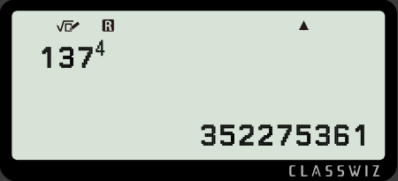



Evaluate using exponents
This is the “power” button. Insert the base and exponent.
Example
Evaluate
Press

Slide 21
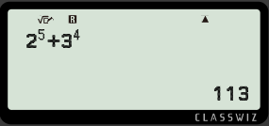




Evaluate using exponents
When using different bases and exponents, ensure to scroll to the right to exit the “power” button
Evaluate
= 113
Press

Slide 22

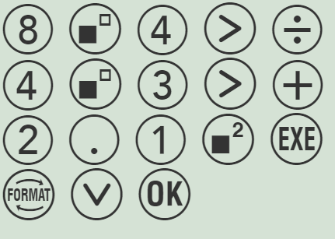
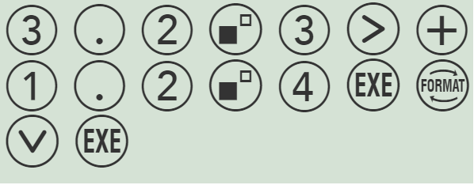
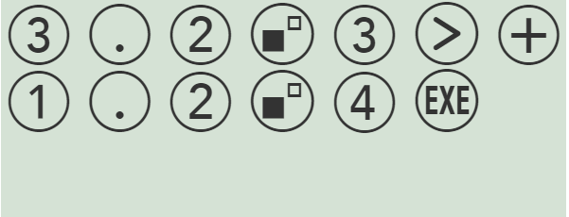
Evaluate using exponents
Evaluate the following ensuring you write all the digits from your calculator display.
Evaluate the following ensuring you write all the digits from your calculator display.
Answer = 34.8416
Answer = 68.41

Slide 23




Evaluate using exponents
Evaluate the following. If your answer is a decimal, write all the digits from your calculator display.
Evaluate
b) Evaluate
c) Evaluate
d) Evaluate

Slide 24

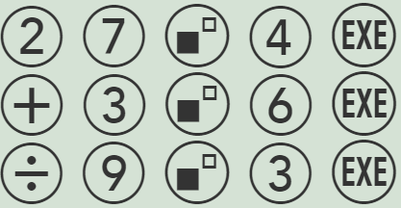



Evaluate using exponents
2) Sofia followed this function machine. Her input was 27. Her output was 730.
To the power of 4
Add 3⁶
Divide by 9³
Which of the following buttons did she press to get the correct answer?
a
b

Slide 25
Evaluate using exponents
Evaluate the following. If your answer is a decimal, write all the digits from your calculator display.
2800
Evaluate
3
b) Evaluate
c) Evaluate
4.6305
d) Evaluate
13

Slide 26

Evaluate using exponents
2) Sofia followed this function machine. Her input was 27. Her output was 730.
To the power of 4
Add 3⁶
Divide by 9³
Which of the following buttons did she press to get the correct answer?
a
b

Slide 27
Powers and roots using a calculator
Evaluate using square and square root buttons
Evaluate using exponents
× 10^{x} button on a calculator

Slide 28

× 10^{x} button on a calculator
Simplifying in mathematics is very important.
We multiply numbers with the base of 10 a lot in mathematics and science.
It is such an important base, it has its own button.
This allows us to quickly evaluate when we multiply a number with a base of 10.

Slide 29
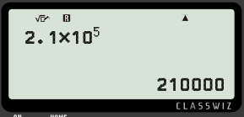

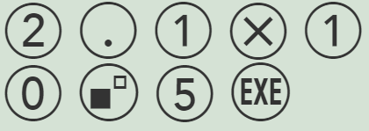


× 10^{x} button on a calculator
Example
Evaluate
2.1 ✕ 10 ✕ 10 ✕ 10 ✕ 10 ✕ 10

Slide 30
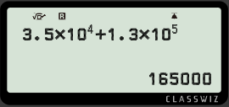
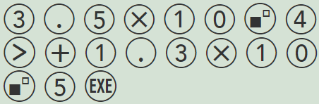
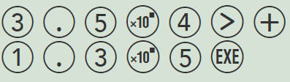

× 10^{x} button on a calculator
Example
Evaluate

Slide 31

× 10^{x} button on a calculator
Which of the following is the correct evaluation of ?
576 000
57 600
5.76000
5760

Slide 32

× 10^{x} button on a calculator
Evaluate the following:
a)
b)
c)

Slide 33
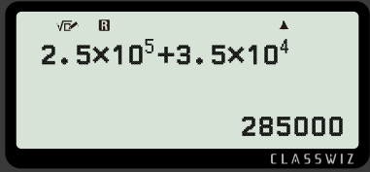
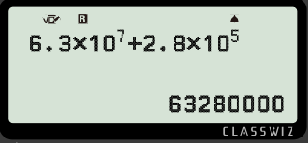

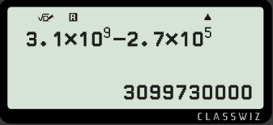
× 10^{x} button on a calculator
2) Work out the missing exponents.
a)
b)
c)

Slide 34
× 10^{x} button on a calculator
Evaluate the following:
a)
b)
c)
17 000
364 000 000
13 320

Slide 35
× 10^{x} button on a calculator
2) Work out the missing exponents.
a)
b)
c)

Slide 36
Powers and roots using a calculator
Evaluate means to find the value of a numerical or an algebraic expression.
This is the “square” button. It will square the number.
This is the “square root” button. It finds the square root of any number.
This is the “power” button. Insert the base and exponent.
This quickly multiplies a number with a base of 10.

Slide 37

© Oak National Academy 2023.
Produced in partnership with Mathematics in Education and Industry.
Licensed on the Open Government Licence v3.0, except where otherwise stated. See Oak terms and conditions.

